Slide 1

Business Intelligence project Analysis On Canadian sales Dataset
By:
Haozhou Wang
Hemanchal Joshi
Rishi Karki

Slide 2

Introduction
Dataset-Sales data across Canada
Analyze the data on terms of business Intelligence parameters
Use of Tableau for visualization of the dataset
Observation and conclusions which can lead to various decision-making techniques
Recommendations on the basis of the observations

Slide 3
Sales Dataset Summary
Sales across Canada on the basis of 13 provinces and 8 regions
Three main Product Category of sales
Furniture
Office Supplies
Technology
Contains returns which we considered outliers
Four main Consumers
Consumers
Home Office
Small Business
Corporate consumers

Slide 4
Objectives
Analyze the Canadian sales dataset and observes fluctuations on basis of various parameters
Selection of parameters and KPI to observe the business fluctuations
Perform cost-benefit and swot analysis in order to analyze the business context
Buiding dash-board and Pivot table to visualize the inferencing provided by the dataset
Provide recommendation and decision-making interface on the basis of analysis

Slide 5

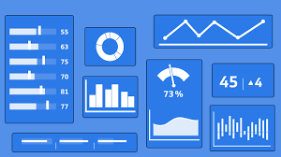
Key Performance Indicators
The Key Performance indicators we included in our analysis are:
Total Sales and difference of sales on basis of Provinces
Current profitable categories of sales in various Provinces
Sales vs Profit among various categories of products
Total Customers and change of customers flow
per year
Consumer Segment inferencing the type of consumers that contribute to the sales and profit

Slide 6
SWOT Analysis
Strengths
Consumers (Increasing consumers)
Weakness
Category with slow or negative profit(Furniture)
Opportunities
Provincial selection on basis of sales(Focus on Technology, Sales in Nuvanut and New foundland)
Threats
Negative review of products
Product Category sold/profitable (Technology)
Province with highest sales/profit(Ontario)
Fast shipping(Order date vs Ship date)
Province with least sales(Nunavut)
Customer dependency(Ship faster, Quality Products)
Attracting customer with discounts (Provide discounts)
Competitive Market
Province with slow or negative profit(New Foundland)
Slow Shipping

Slide 7
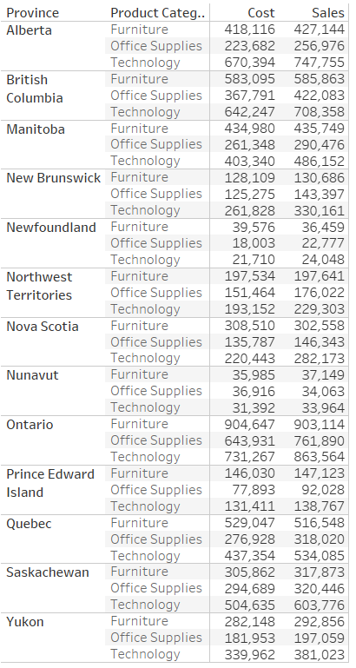
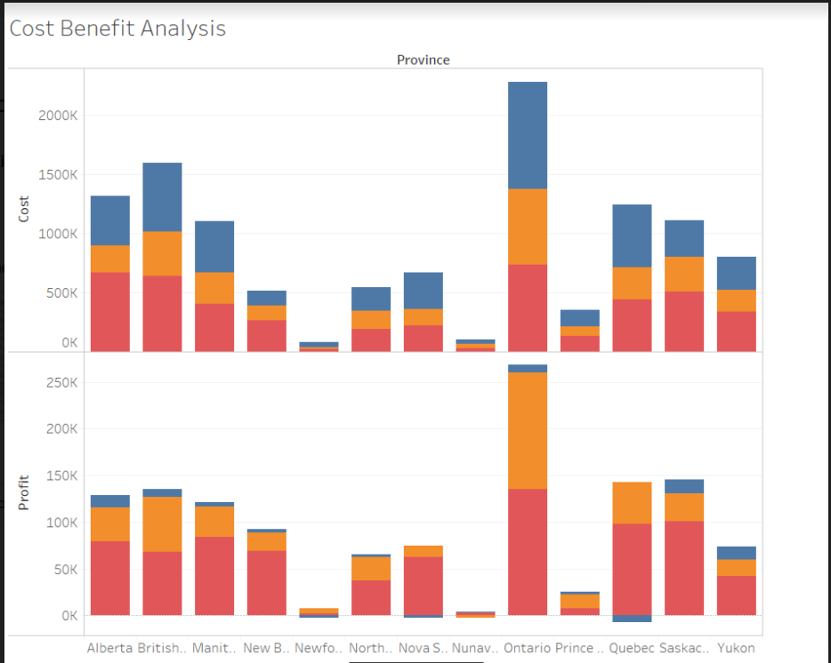
Cost-Benefit Analysis
Assumed Cost
Direct and indirect cost
Shipping and Handling cost
Manpower cost
Deprecations
Annual Costs
Benefits
Consumer Satisfaction
Revenue/ Production Increase
Organization Efficiency

Slide 8

Visualization using Tableau

Slide 9
Conclusion
With respect to Provinces
Ontario has maximum sales and profit
The Least Sales is in Nunavut
The Least profit is in New Foundland
Consumers in Alberta are increasing in number
Consumers in Ontario are decreasing
With respect to product category
Maximum profit and Sales is in Technology category
Least Profit is in Furniture Category
Least Sales is in Office Supplies category
With respect to Consumer Types
Profitable Corporate Customers
Least profitable small Business

Slide 10
Recommendations
Provinces
Increase focus on Consumers of Alberta (Increasing market)
Analyze the reasons for decrease in consumer number from Ontario (as it has highest sales and profit over the years)
Provide more offers, discounts and efficient service to increase sales and profit in provinces like New found land and Nunavut
Product Categories and consumers
Increase profit margin or furniture as it has depreciation over the years and is contributing to loss rather than profit (can even drop products that are affecting this category)
Promote Furniture products and Office Supplies
Increase B2B marketing as most consumers are corporate consumers

Slide 11
Further Analysis
Collective feedbacks from customers
Fast and efficient Shipping for customer satisfaction
Use data mining tools for prediction and association mining
Better cancellation and return policies
Additional discounts and Promotion codes

Slide 12
THANK YOU Any Queries?

